Slide 1
Secure authentication method using Honey key Password in Online Shopping
Team Details
1. A.Manidhar(20EG105303)
2. B. Sucharitha(20EG105316)
3. L. Sravanthi(20EG105708)
Project Supervisor
Name : Mrs. P. Swarajya Lakshmi
Designation : Assistant Professor

Slide 2
Introduction
One of the most widely used safe mechanisms for online applications in the real world is password-only authentication. However, it is easily vulnerable to a real threat - password leaks caused by both internal and external attackers. Insiders may purposefully steal credentials or unintentionally leak them, while external attackers may compromise the password file kept on the authentication server. As of right now, there are two primary methods for dealing with the leak: the use of honeyword technique for external attackers and augmented password-authentication key exchange (aPAKE) for insiders. But none of them are able to withstand both blows. In order to bridge the gap, we introduce the concept of honey PAKE (HPAKE), which enables the authentication server to identify password leaks and provide security that goes beyond the limitations of aPAKE.

Slide 3
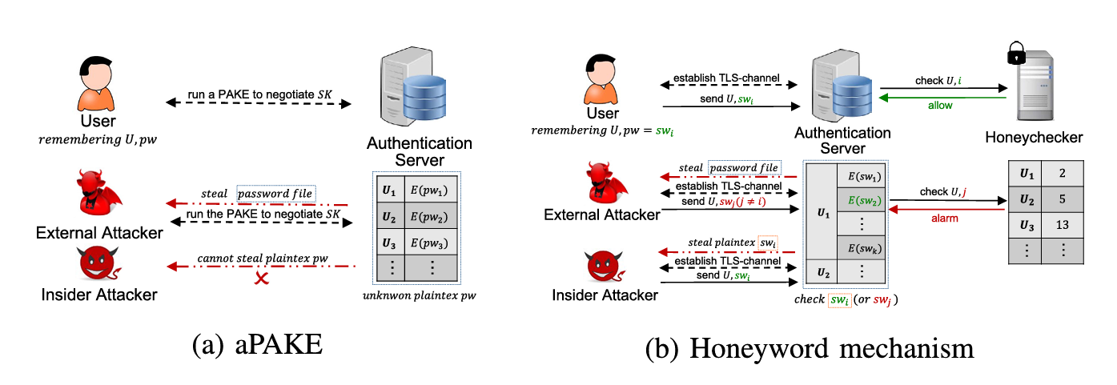
Introduction

Slide 4
Problem Statement
The prevalent use of password-only authentication in online shopping platforms has led to vulnerabilities from both external attacks and insider threats. Current methods, susceptible to password leaks and the risks associated with augmented password-authenticated key exchange (aPAKE), call for an innovative solution. This project introduces Honey Password Authenticated Key Exchange (HPAKE) to address these concerns. HPAKE implements a stringent registration process, mandating users to upload a text file and provide a secret key pair. This approach not only strengthens authentication but also proactively identifies potential password leaks. Given the limitations of existing methods in the realm of online shopping security, there is an urgent need for comprehensive solution like HPAKE. Its integration represents a substantial advancement, offering improved defense against both external adversaries and insider threats, thereby elevating the overall security of user credentials in the dynamic digital landscape.

Slide 5
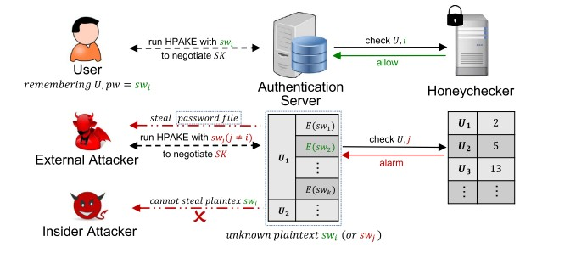
Proposed Method

Slide 6
Proposed Method
In proposed method password authenticated key exchange mechanism is used to secure user authentication process using (HPAKE) model that provides the theoretical basis for this construction and is backed by crypto graphic proofs of security When user registers with application a security key with unique input values are taken in the form of text file and security key for data is generated by server which is sent to user mail id for login. User need to login to application with same security key and same file with same data in the file. This method is shown in online purchase platform where fraud transactions from users with wrong payment details are blocked by admin.

Slide 7
Proposed Method
HPAKE Extra enhances security through an AES-encrypted server-authenticated channel, safeguarding communication. It employs honeywords generated via a probability model, adding complexity to thwart potential attacks. The honeychecker validates the authenticity of honeywords, bolstering the authentication process. A secure channel between the authentication server and honeychecker ensures confidential information exchange. Notably, the protocol strictly prohibits server access to password plaintext, mitigating risks associated with real-password-based methods. HPAKE Extra prioritizes alternative, secure approaches, contributing to a robust authentication system. This comprehensive framework strengthens user credential protection and system integrity. In essence, HPAKE Extra combines encryption, honeywords, and secure channels to fortify authentication in an innovative and secure manner.

Slide 8
Experiment Environment
Software Requirements:
Operating System - Windows XP
Coding Language - Java/J2EE(JSP,Servlet)
IDE - Netbeans
Back End - MySQL

Slide 9
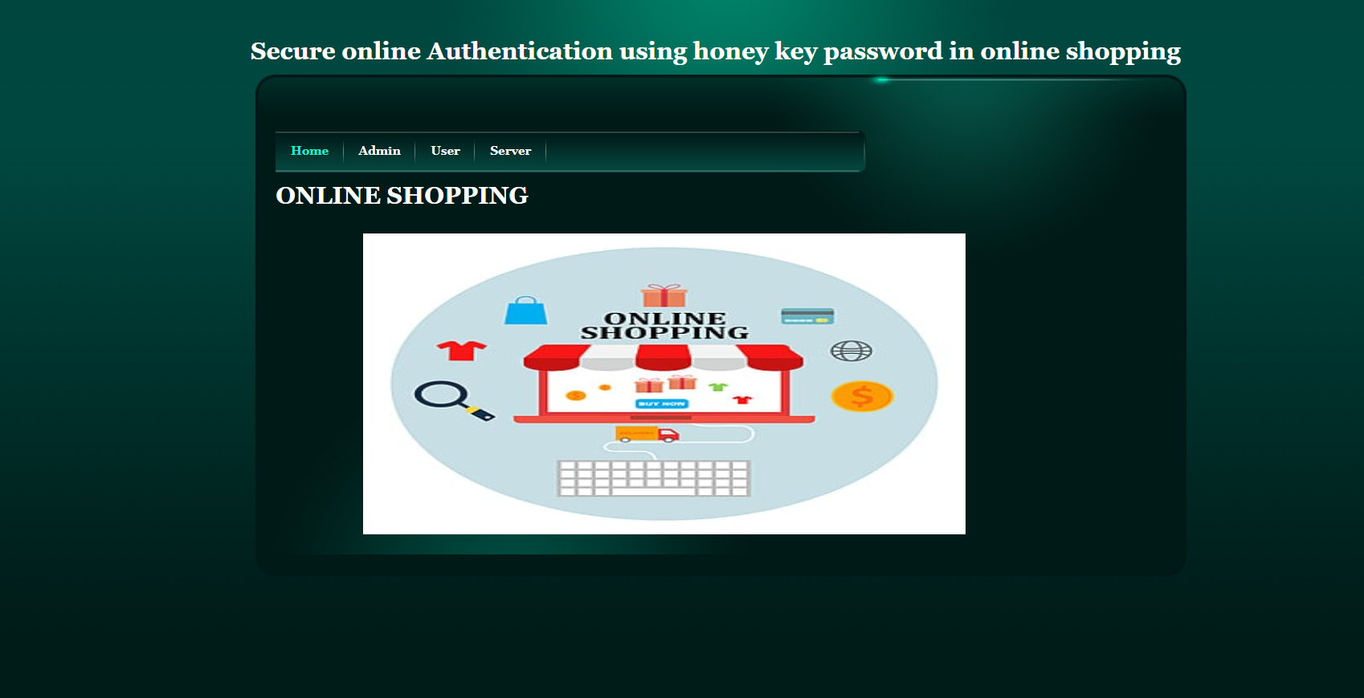
Experiment Screen shots

Slide 10
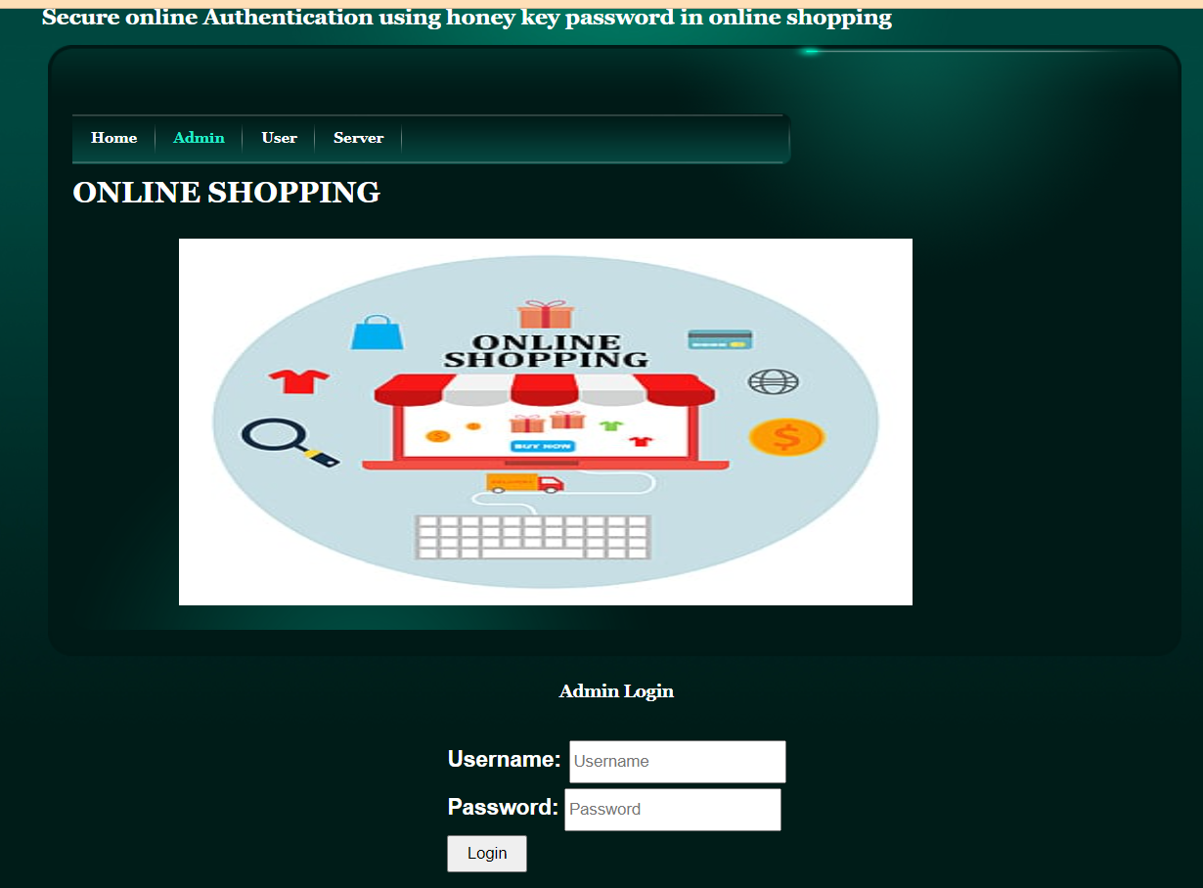
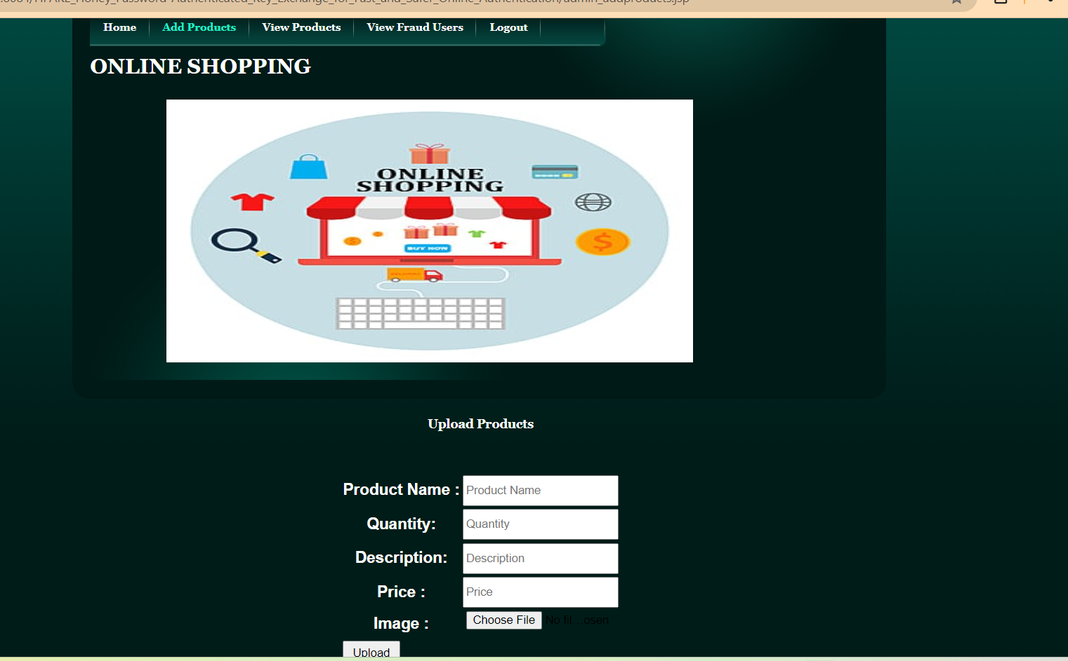
Admin Page
Experiment Screen shots

Slide 11

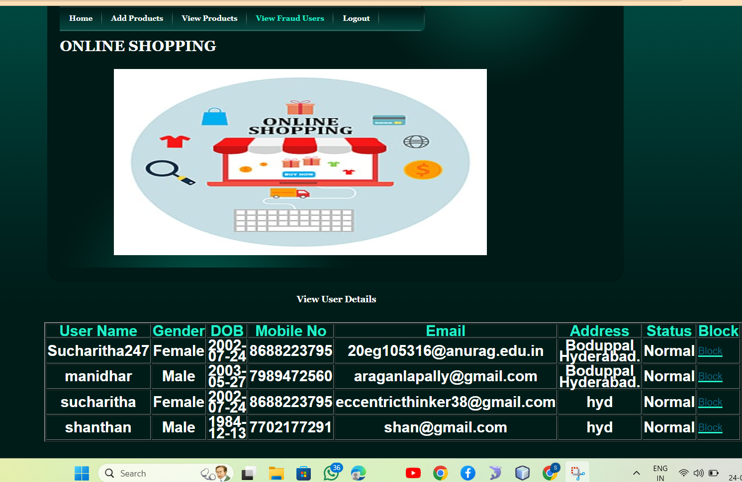
Experiment Screen shots

Slide 12
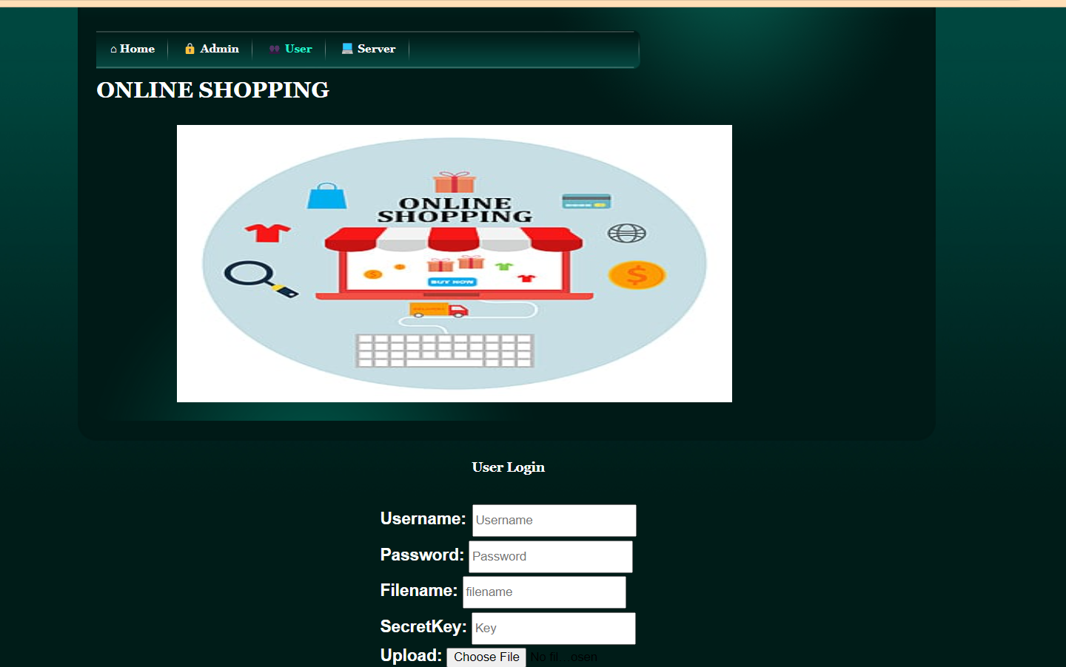
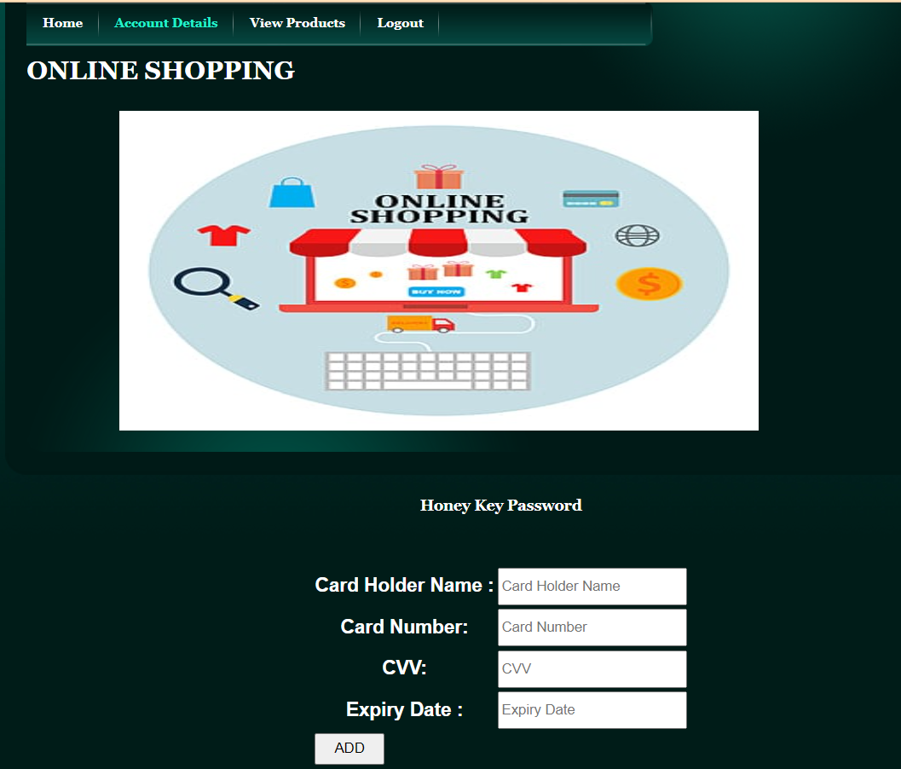
Experiment Screen shots
User Page:

Slide 13


Experiment Screen shots

Slide 14
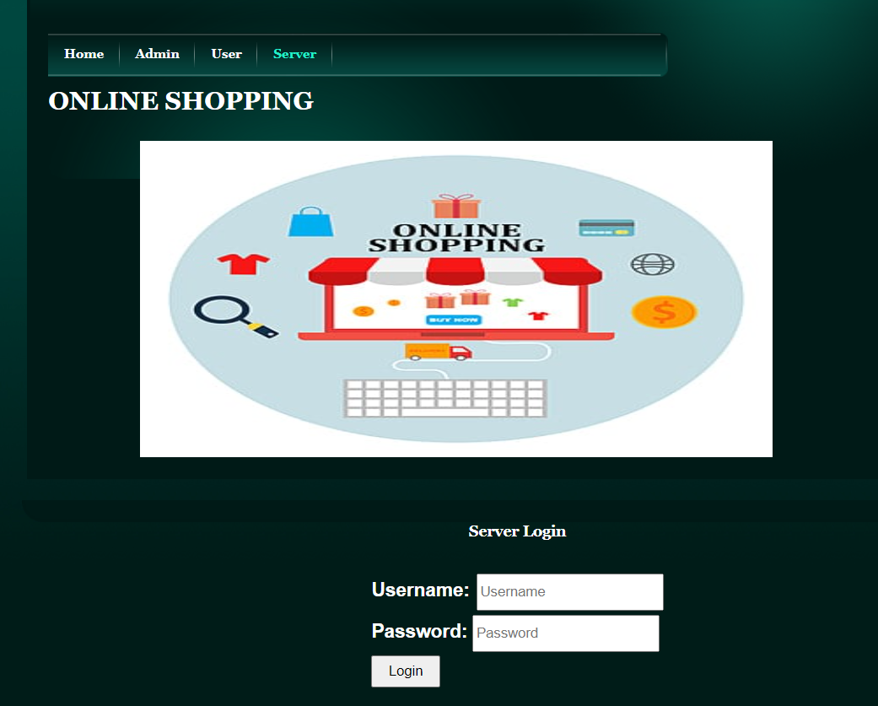
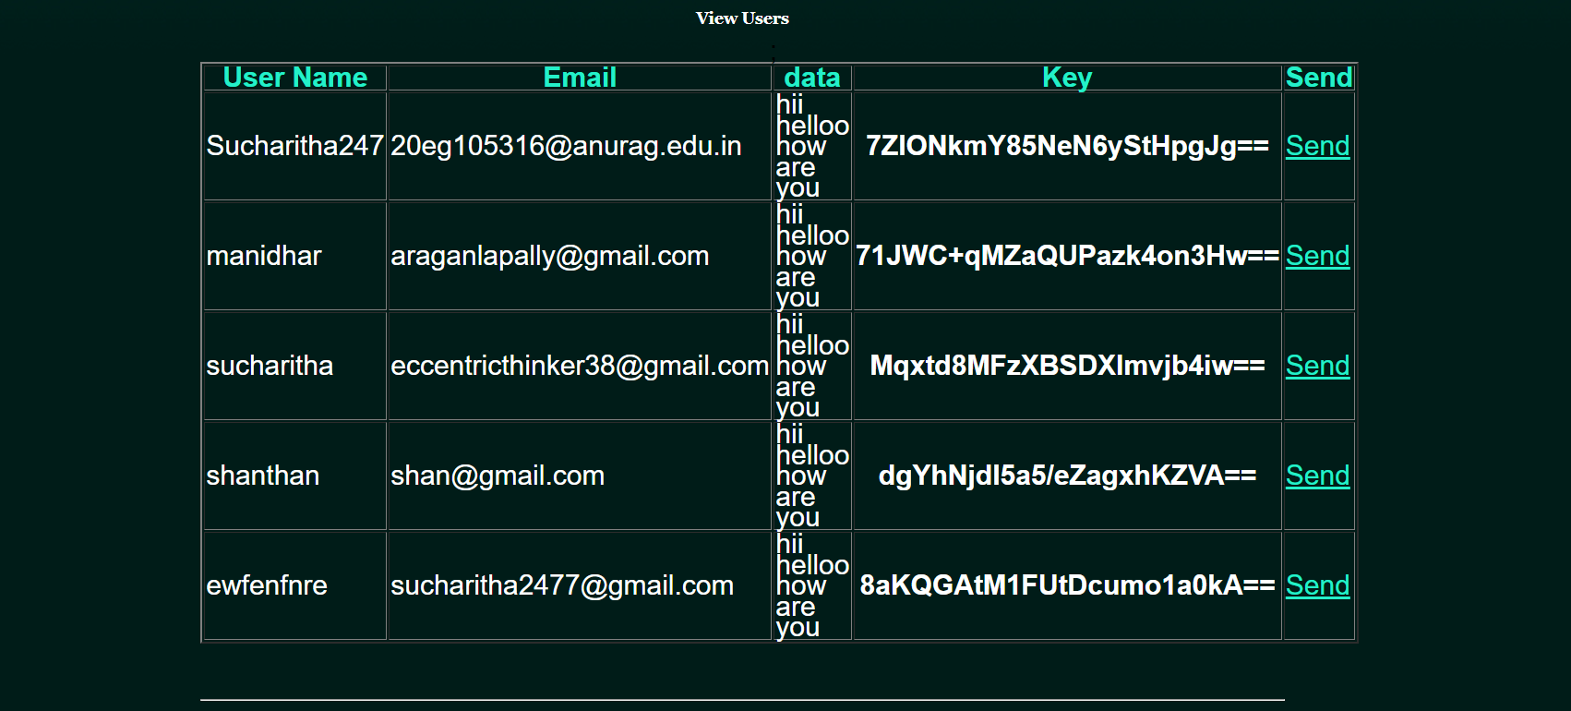
Experiment Screen shots
Server Page:

Slide 15
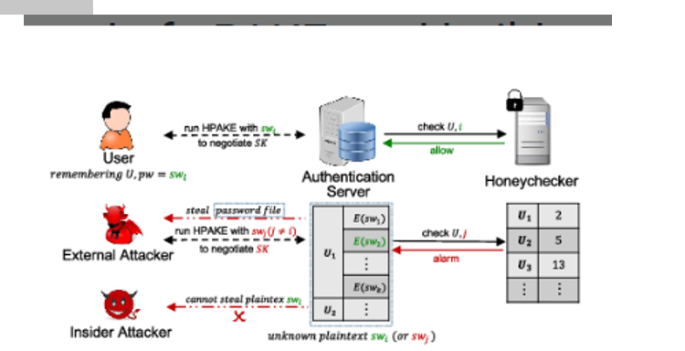
Finding
We propose the notion of HPAKE, which is the first of its type, achieving the advantages of the honeyword and aPAKE techniques, i.e., detecting the password leakage caused by external attackers and preventing the insider from getting the password plaintext.

Slide 16
Justification
Parameters Improved:
Computational cost:
Total Client Cost=Sclient​+Eclient​
Total Server Cost=Sserver​+(t−1)×Eserver
The HPAKE protocol optimizes the computational cost by parallelizing the calculation of session keys, making it acceptable for the authentication server.
Communication cost:​
HPAKE reduces communication rounds, considering the higher round-trip delay time on the client-server communication compared to other parts of the protocol.
RHPAKE​=ROPAQUE​−2
​

